Slide 1

Network Time Protocol
Synchronizing Time Across the Internet

Slide 2

What Is NTP?
The Foundation
Network Time Protocol synchronizes computer clocks across networks with precision.
History & Design
Developed by David L. Mills in 1985. Operates over UDP port 123 globally.

Slide 3
Why NTP Matters
Critical Applications
What It Prevents
Financial transactions and trading systems
Without accurate time synchronization, systems experience:
Secure authentication protocols
Distributed database consistency
Clock drift causing service failures
System logging and audit trails
Security vulnerabilities in time-sensitive operations
Data inconsistency across networks
Audit trail problems and compliance issues

Slide 4

How NTP Works
01
02
Client Initiates Request
Server Responds
NTP client sends a time query packet to a designated NTP server, including its local timestamp.
The server receives the request, records the reception time, and sends back accurate time data from its reference clock.
03
04
Client Calculates Offset
Clock Adjustment
The client receives the response and computes the time difference and network delay using precise mathematical calculations.
The client adjusts its local clock based on calculated offset and delay, achieving synchronization within milliseconds.

Slide 5




Understanding NTP Strata
NTP uses a hierarchical system where lower stratum numbers indicate greater accuracy and closer proximity to atomic reference clocks.
Stratum 0
1
Atomic clocks, GPS receivers
Stratum 1
2
Direct connection to reference clocks
Stratum 2
3
Syncs from Stratum 1 servers
Stratum 3+
4
Secondary and tertiary layers

Slide 6
NTP Packet Structure
Each NTP packet contains critical timing information and control fields essential for accurate synchronization.
Field
Purpose
LI (Leap Indicator)
Alerts clients to leap second adjustments
VN (Version Number)
Identifies NTP protocol version (typically 3 or 4)
Mode
Specifies Client, Server, or Peer communication
Stratum
Indicates clock accuracy level in hierarchy
Timestamp Fields
Records originate, receive, and transmit times

Slide 7

Synchronization Mathematics
NTP calculates precise offset and round-trip delay using four timestamp measurements:
t1
Client send time
t2
Server receive time
t3
Server transmit time
t4
Client arrival time
This formula accounts for network latency, achieving accuracy within microseconds.

Slide 8
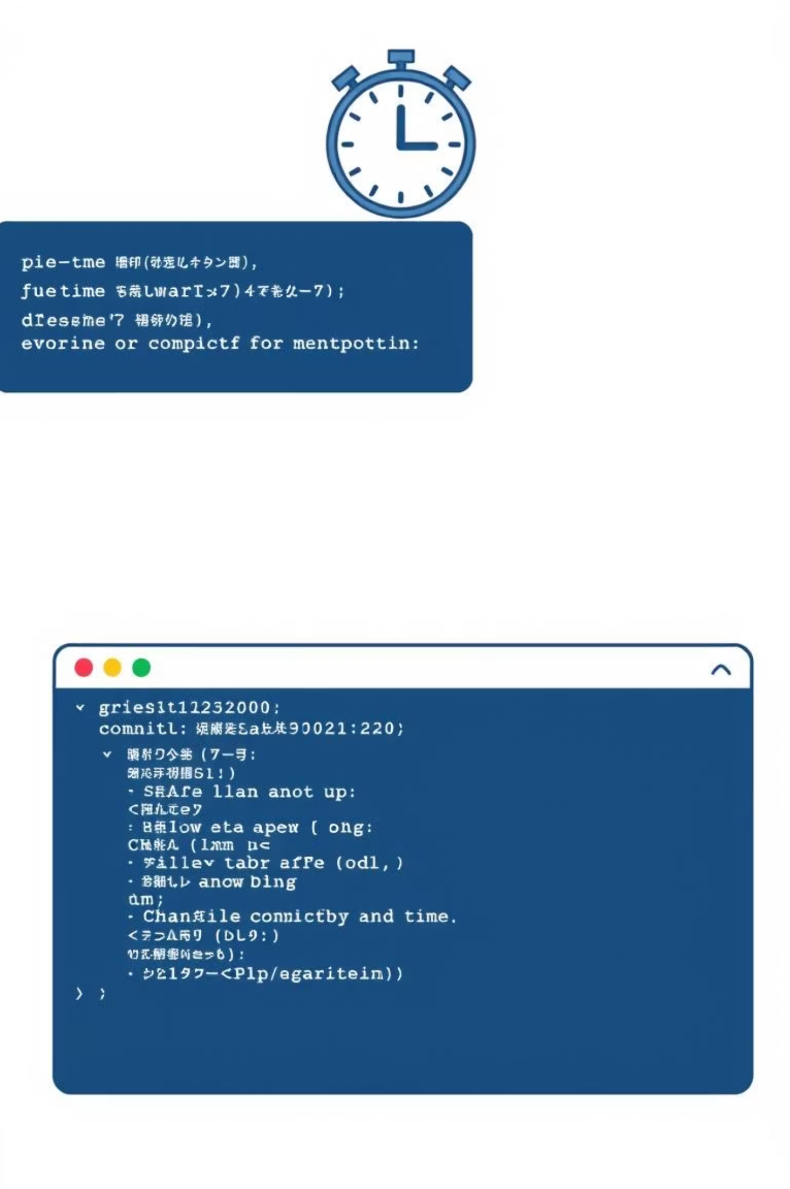
NTP in Windows Systems
Windows includes w32tm.exe, a command-line utility for managing NTP synchronization and viewing time status.
Display Current Time
time /t
Show Date
date /t
Sync with NTP Server
w32tm /resync
Detailed Status Report
w32tm /query /status

Slide 9

Advantages & Limitations
Key Advantages
Known Limitations
Microsecond accuracy across global networks
Depends on stable internet connectivity
Built-in redundancy and fault tolerance
Vulnerable to spoofing without proper security
Worldwide public server availability
Requires ongoing maintenance and monitoring
Enhanced security and data integrity
Latency increases with distance
Low bandwidth consumption
Complex security implementation needed

Slide 10

The Right Time Keeps Everything Right
NTP is the backbone of modern network synchronization, ensuring accuracy, reliability, and security across billions of connected devices worldwide.
Foundation of Digital Trust
NTP enables secure transactions, accurate logging, and data consistency essential to modern infrastructure.
Universal Implementation
From financial markets to mobile networks, NTP synchronizes time across nearly every computer system today.
Future-Ready Protocol
Continuous development ensures NTP remains resilient and secure for emerging technologies and evolving network demands.

